Slide 1
Report on Transition-Based Parser
Longxu Dou
5/6/2019

Slide 2
Catalogue
Recent Progress: Implement Transition-Based parser for CoNLL2019
Basic Transition-Based parser
Research Highlight (Dependency parsing with stack-LSTMs)
Alternate Transition Systems: Arc-Eager

Slide 3
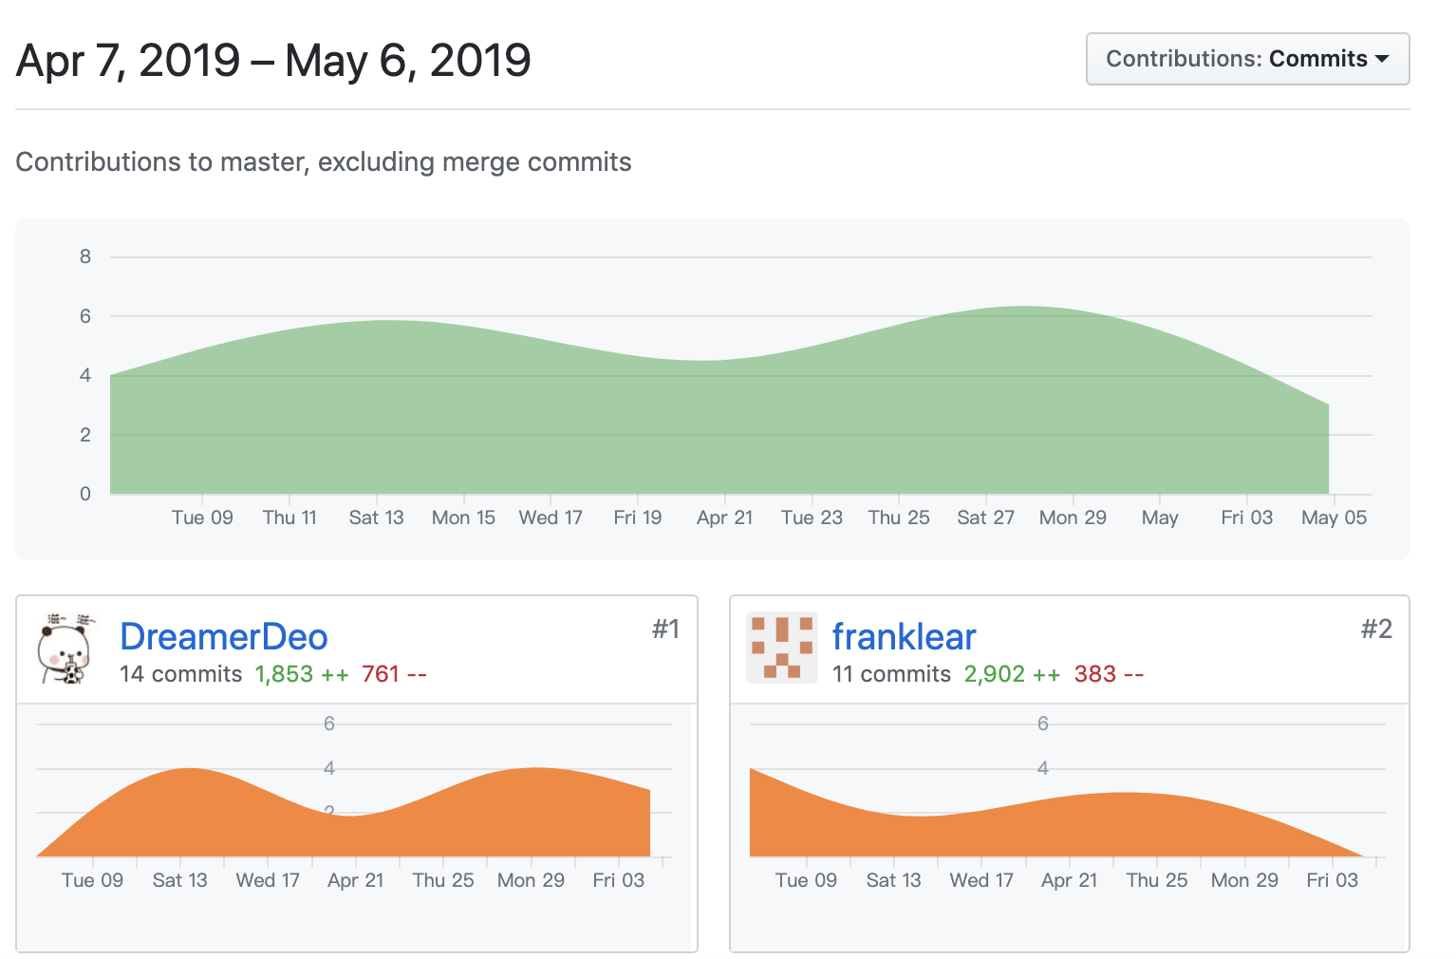
What I have done in this month?
Implement a basic Transition-Based parser using Allennlp.
How to get oracle actions?
List-base arc-eager
Arc-hybrid

Slide 4
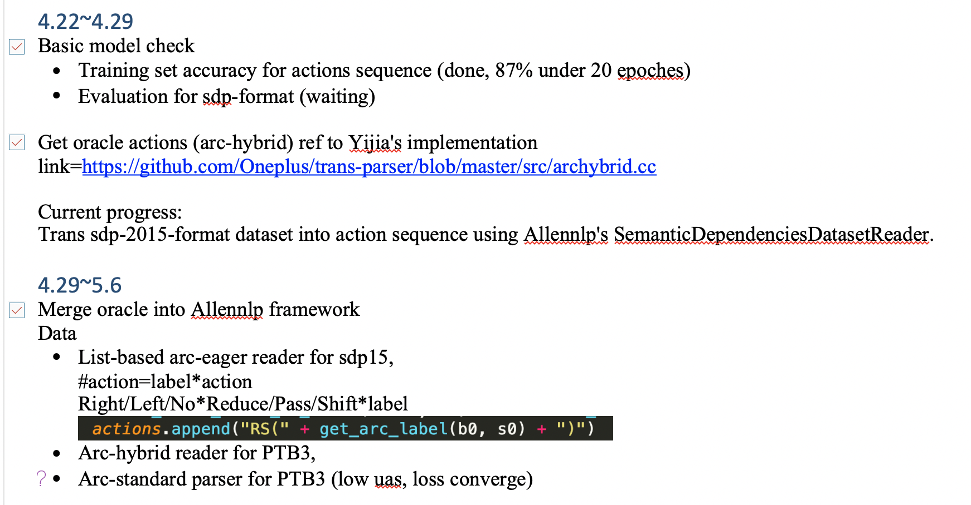
Schedule

Slide 5
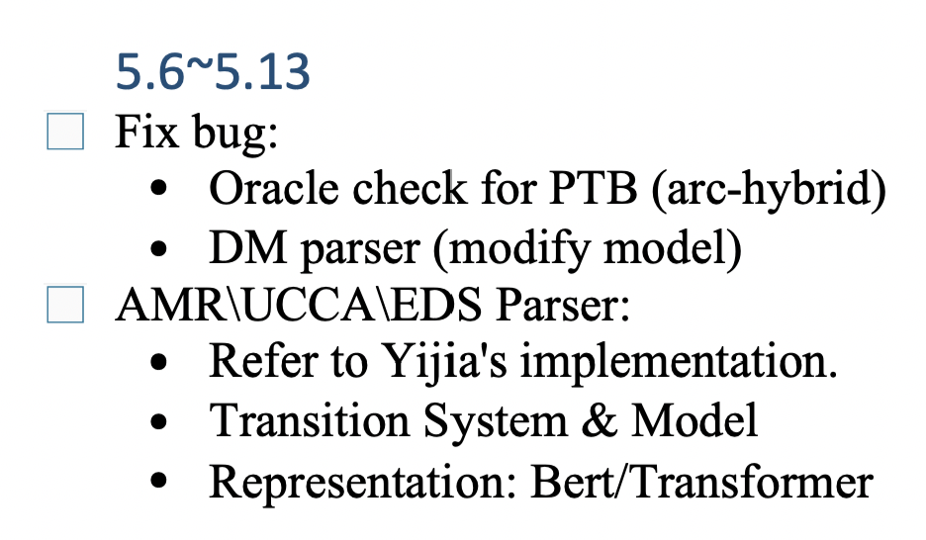
Future Plan

Slide 6
Catalogue
Recent Progress: Implement Transition-Based parser for CoNLL2019
Basic Transition-Based parser
Research Highlight (Dependency parsing with stack-LSTMs)
Alternate Transition Systems: Arc-Eager

Slide 7
Dependency Parsing
Formalizing dependency trees/graphs.
Transition-Based dependency parsing
Shift-reduce parsing
Transition system
Oracle
Learning/predicting parsing

Slide 8
Data-driven dependency parsing
Goal: learn a good predictor of dependency graphs
-Input: sentence
-Output: dependency graph/tree G=(V,A)
Can be framed as a structured prediction task
-very large output space
-with interdependent labels
2 dominant approaches: Transition-Based parsing and graph-based parsing

Slide 9
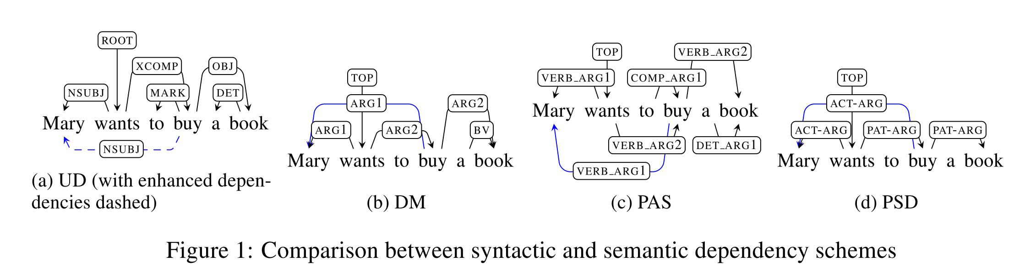
Dependency Parsing: Tree vs. Graph

Slide 10
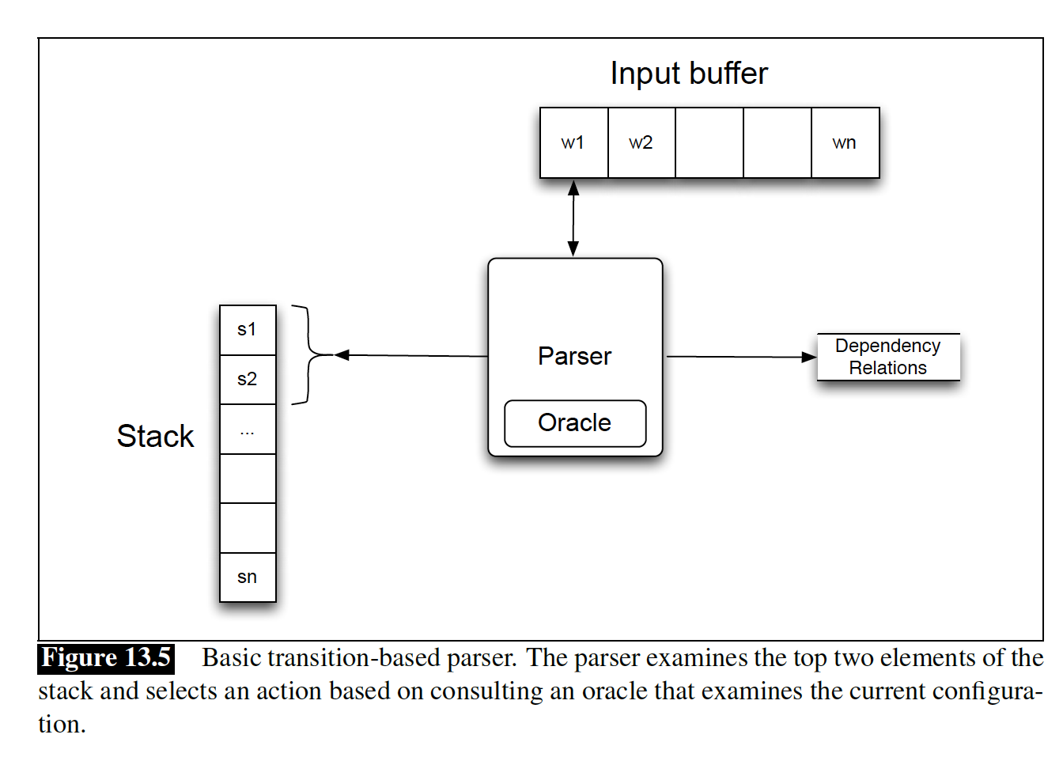
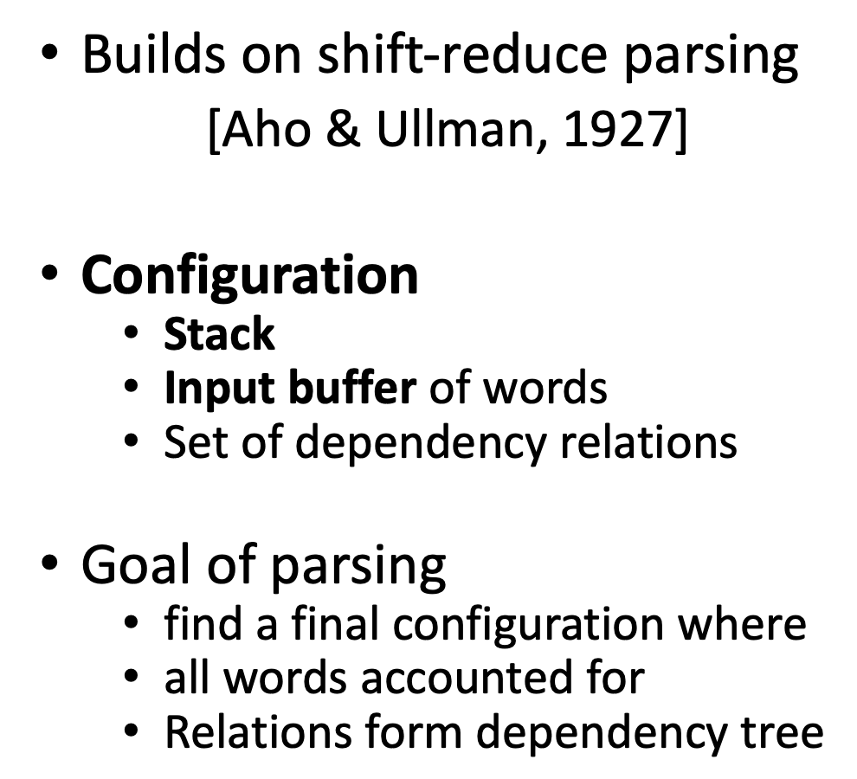
Basic Transition-Based dependency parser

Slide 11
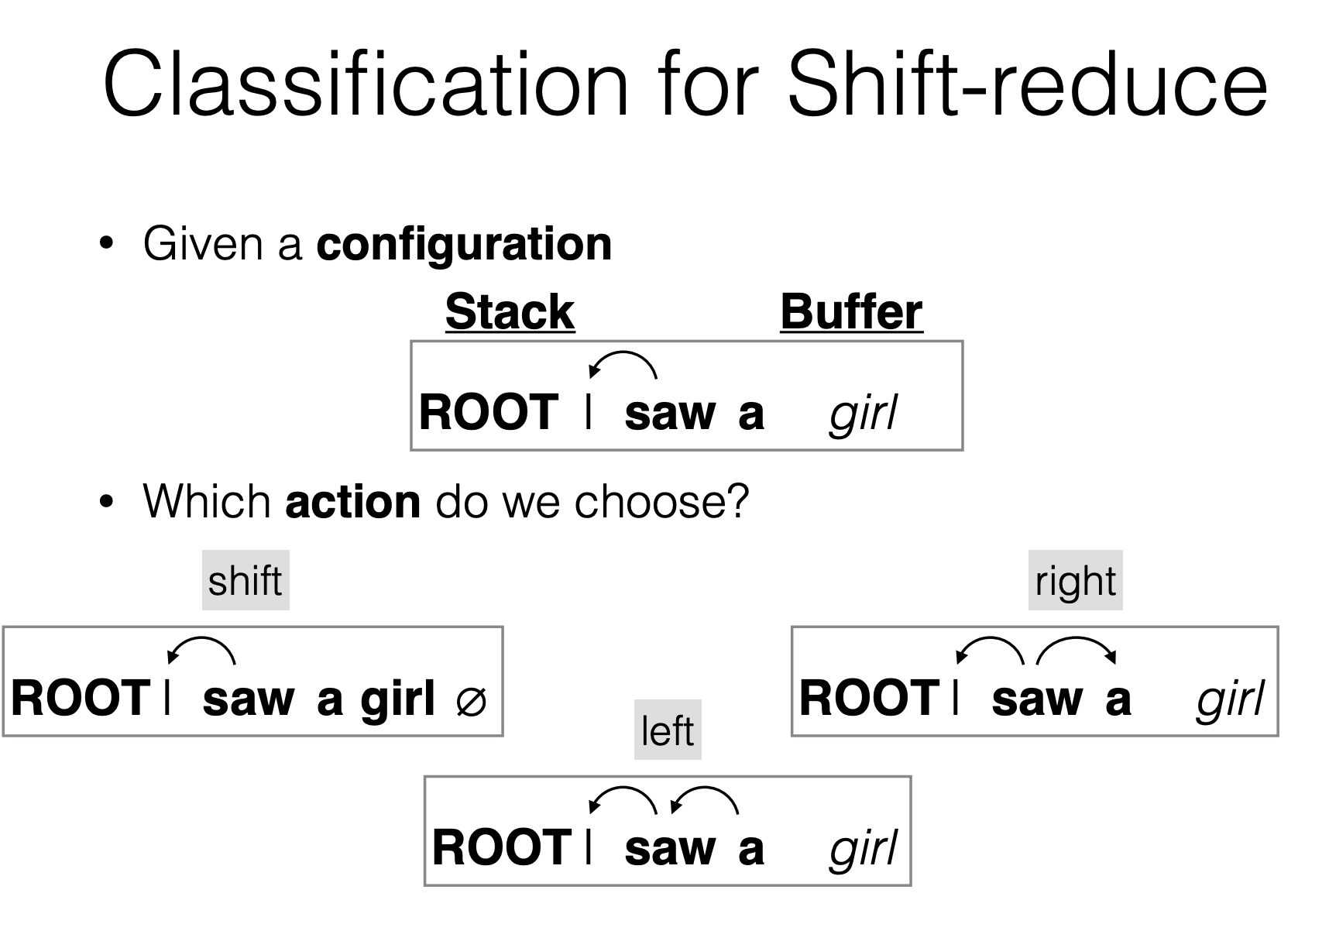

Slide 12
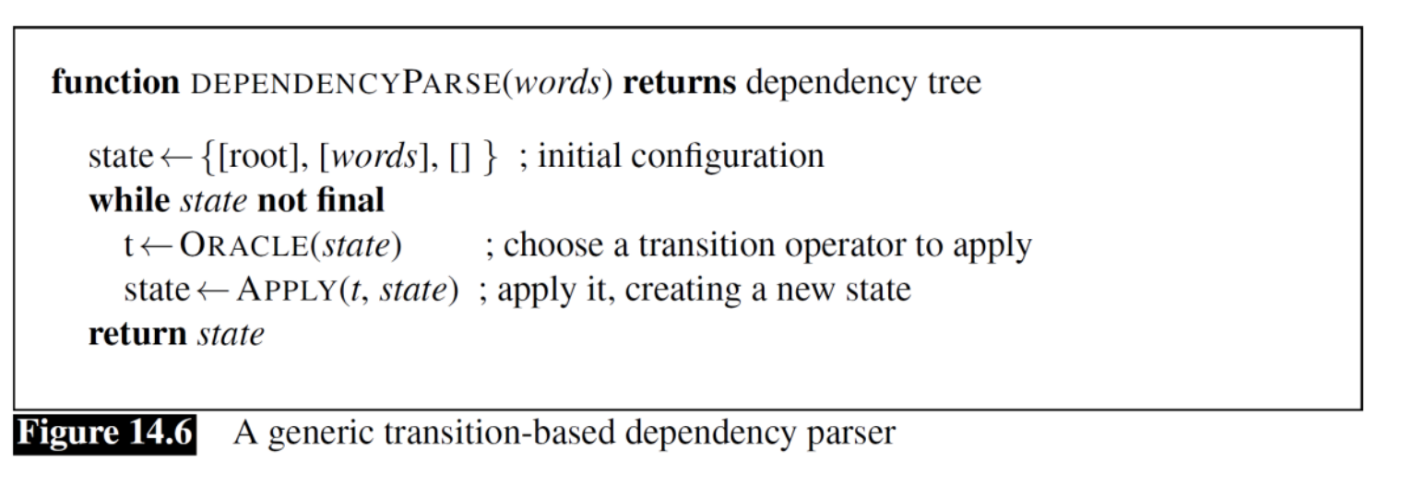
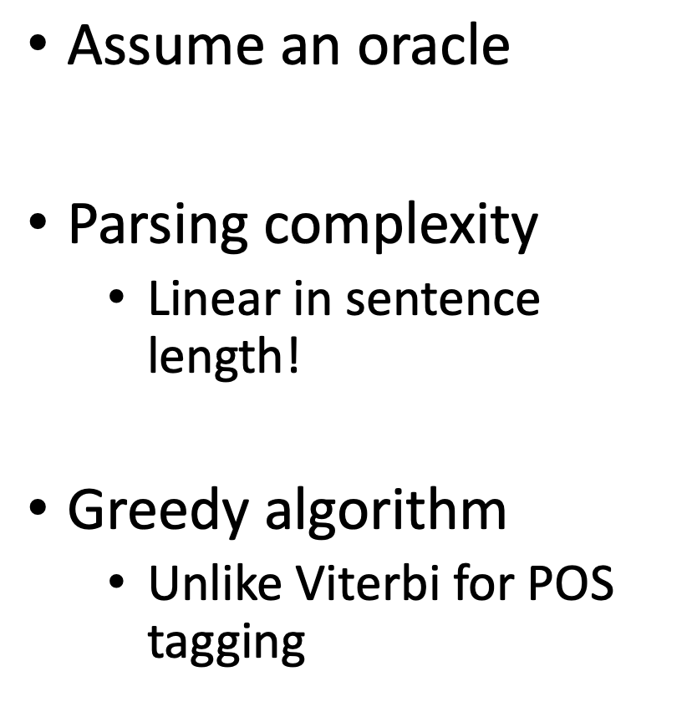
Transition-Based Dependency Parser

Slide 13
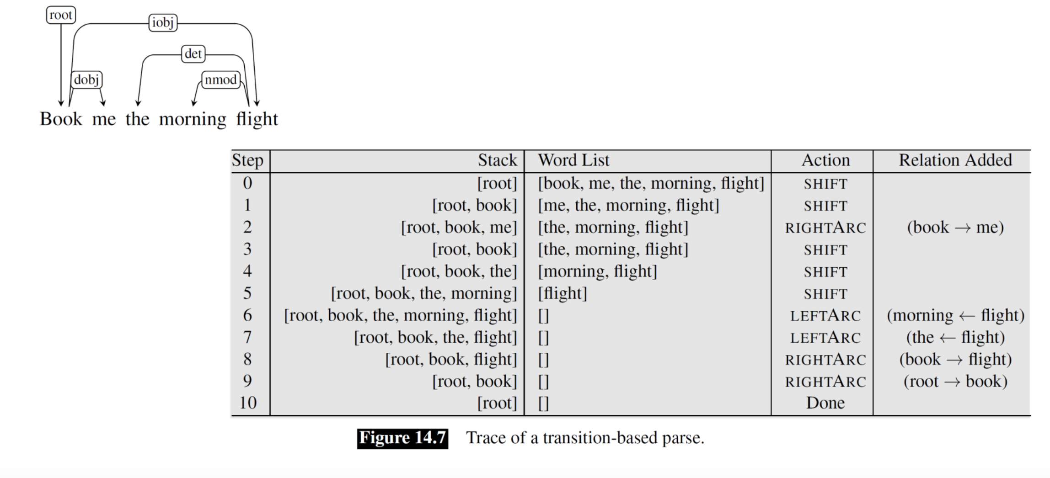
Transition-Based Parsing Illustrated

Slide 14
Where to we get an oracle?
Multiclass classification problem
Input: current parsing state (e.g., current and previous configurations)
Output: one transition among all possible transitions
Supervised classifiers can be used
Open questions
Where do we get training examples?
What are good features for this task?

Slide 15
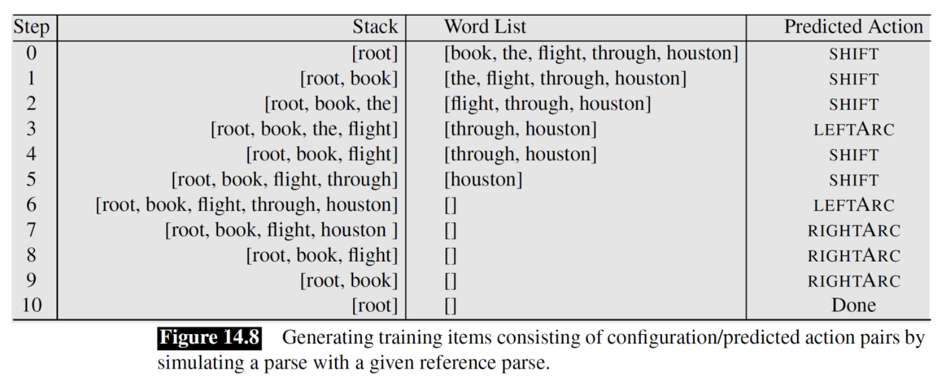
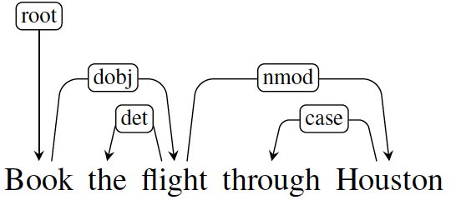
Generating Training Examples
What we have in a treebank
What we need to train an oracle
-Pairs of configurations and predicted parsing action

Slide 16
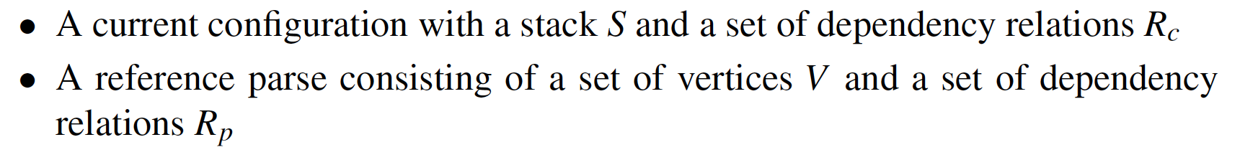
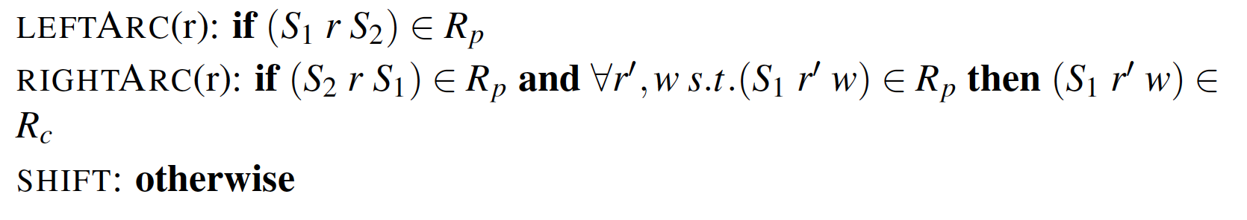
Generating training examples
Approach: simulate parsing to generate reference tree
Given:
Do

Slide 17
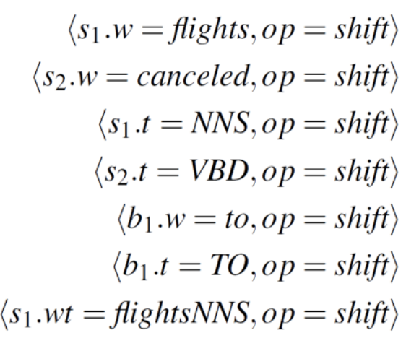
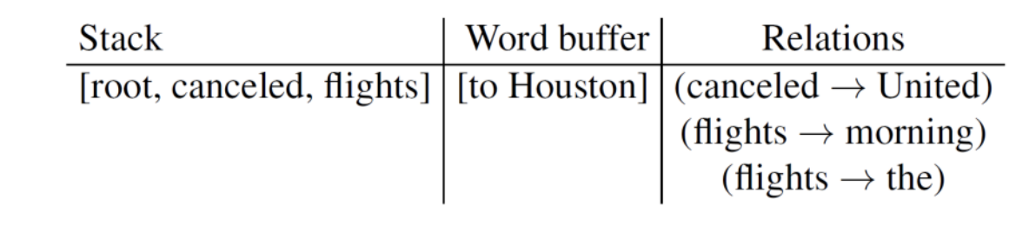
Features
Configuration consist of stack, buffer, current set of relations
Typical features
Features focus on top level of stack
Use word forms, POS, and their location in stack and buffer

Slide 18
Catalogue
Recent Progress: Implement Transition-Based parser for CoNLL2019
Basic Transition-Based parser (Speech and Language Processing)
Research Highlight (Dependency parsing with stack-LSTMs)
Alternate Transition Systems: Arc-Eager

Slide 19
Research highlight: Dependency parsing with stack-LSTMs
From Dyer et al. 2015: http://www.aclweb.org/anthology/P15-1033
Idea
Instead of hand-crafted feature
Predict next transition using recurrent neural networks to learn representation of stack, buffer, sequence of transitions

Slide 20
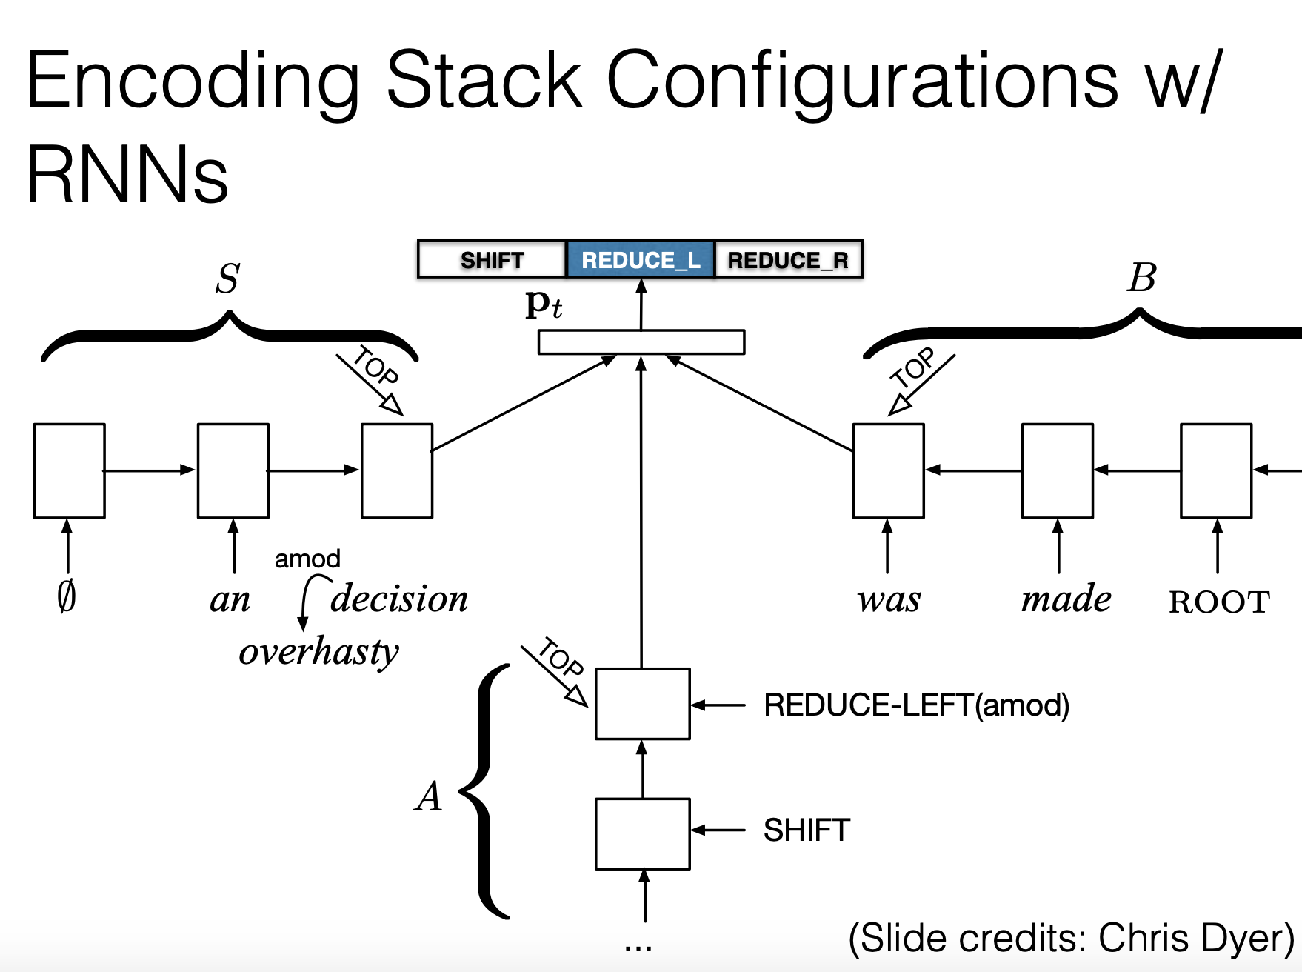

Slide 21
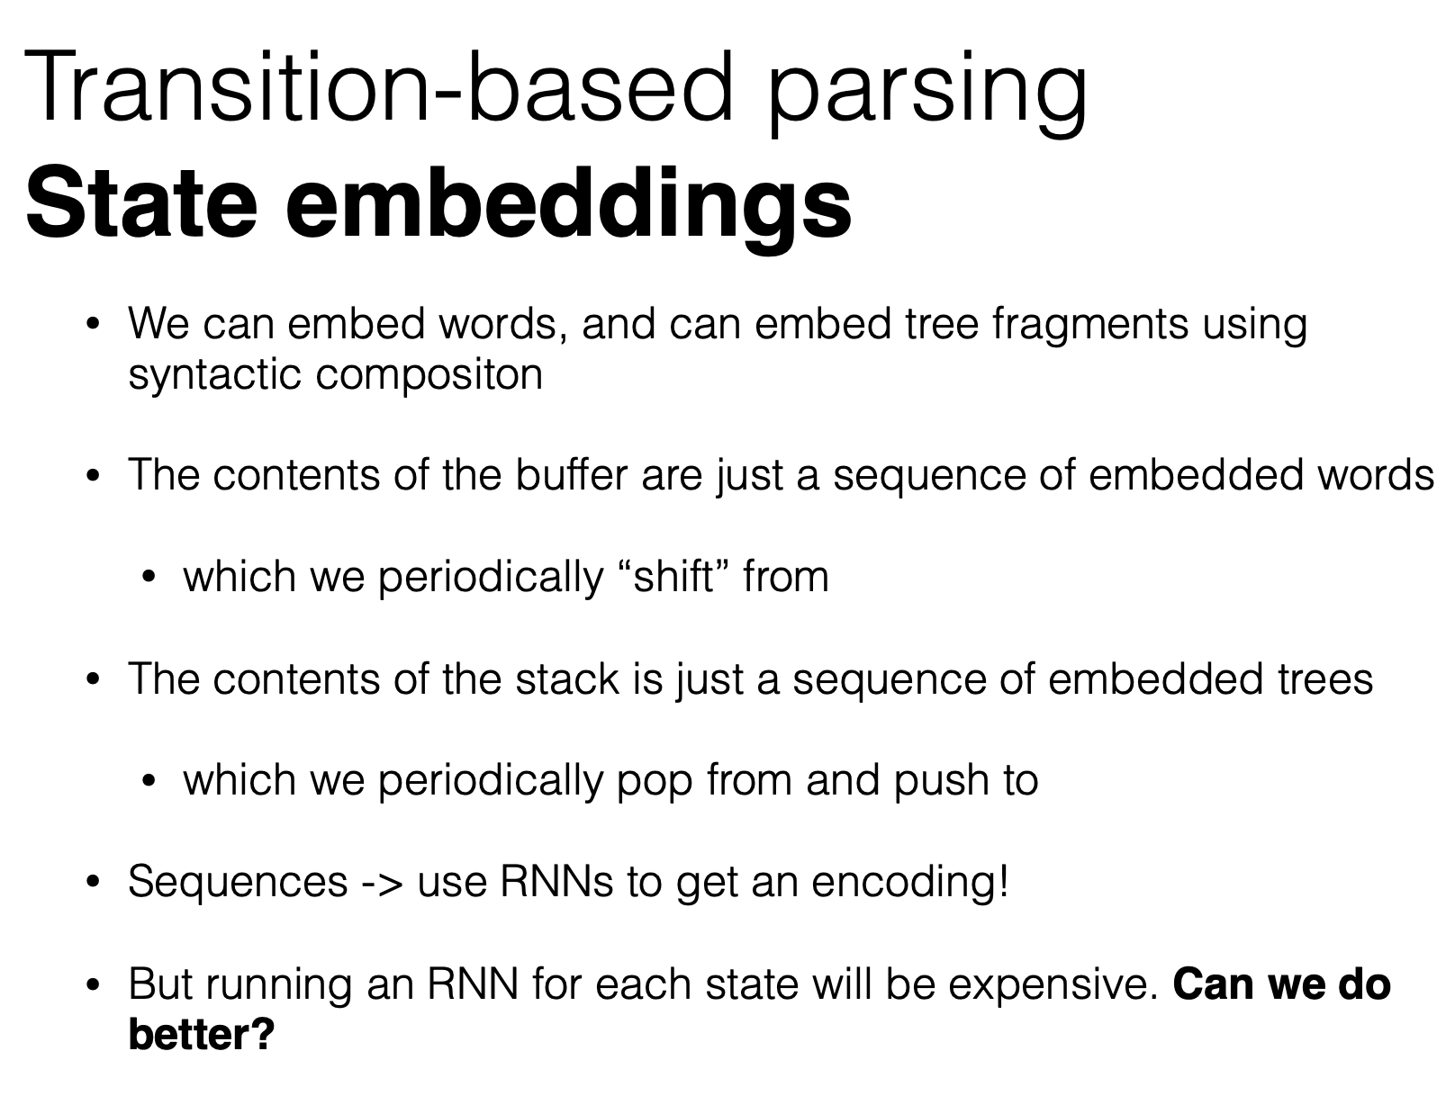

Slide 22
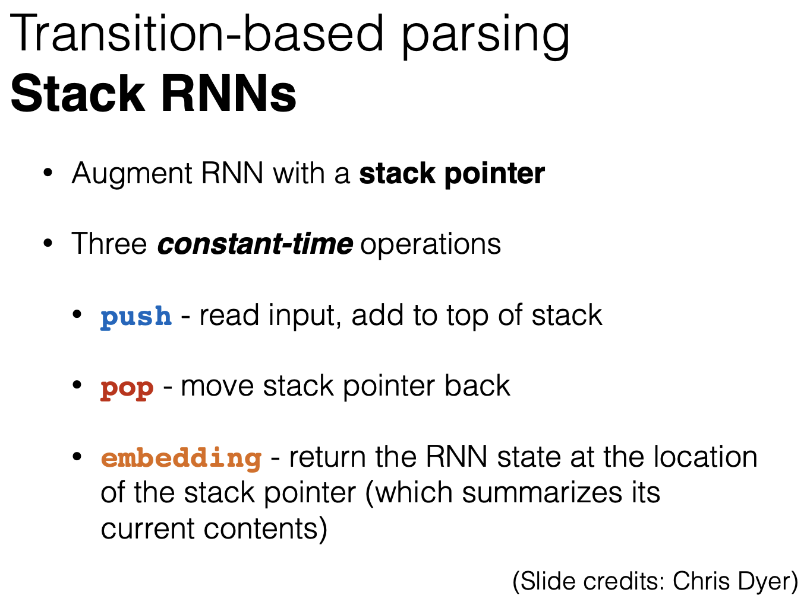

Slide 23
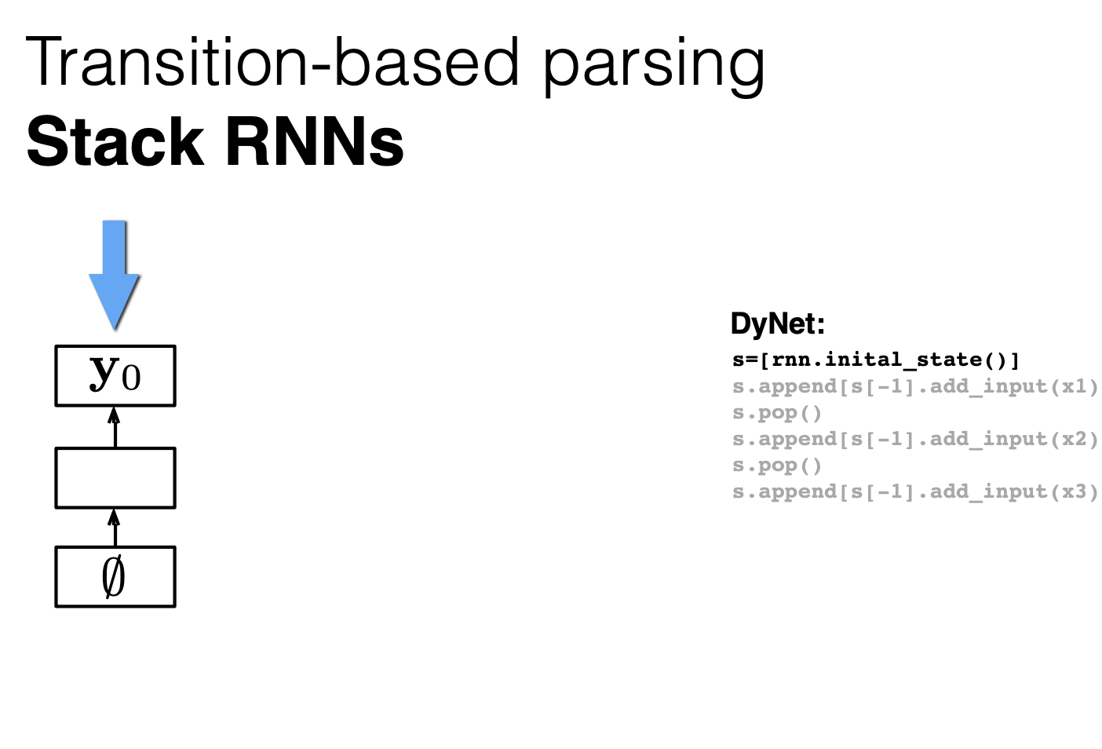

Slide 24
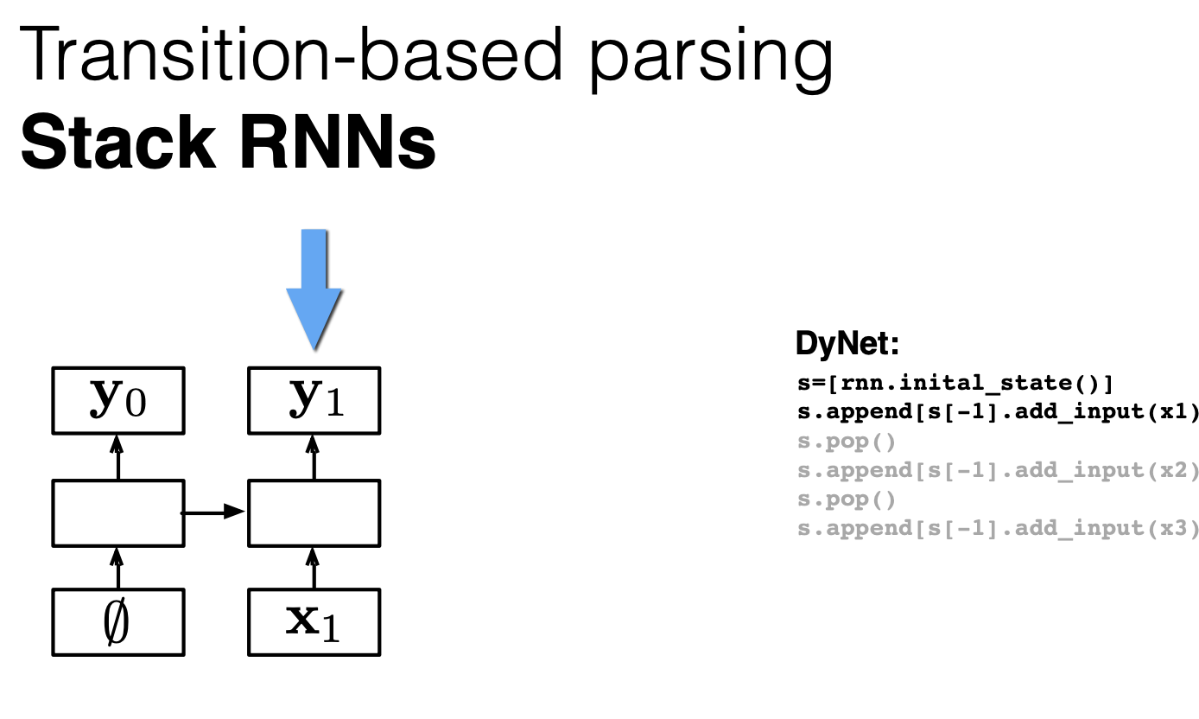

Slide 25
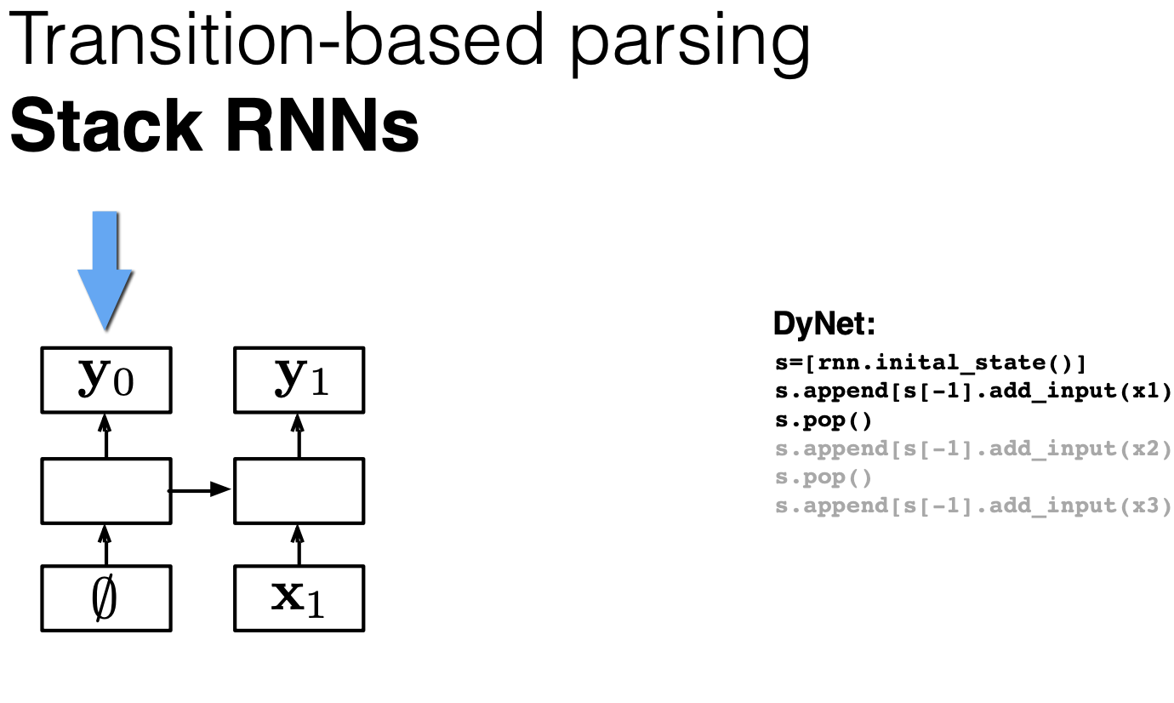

Slide 26
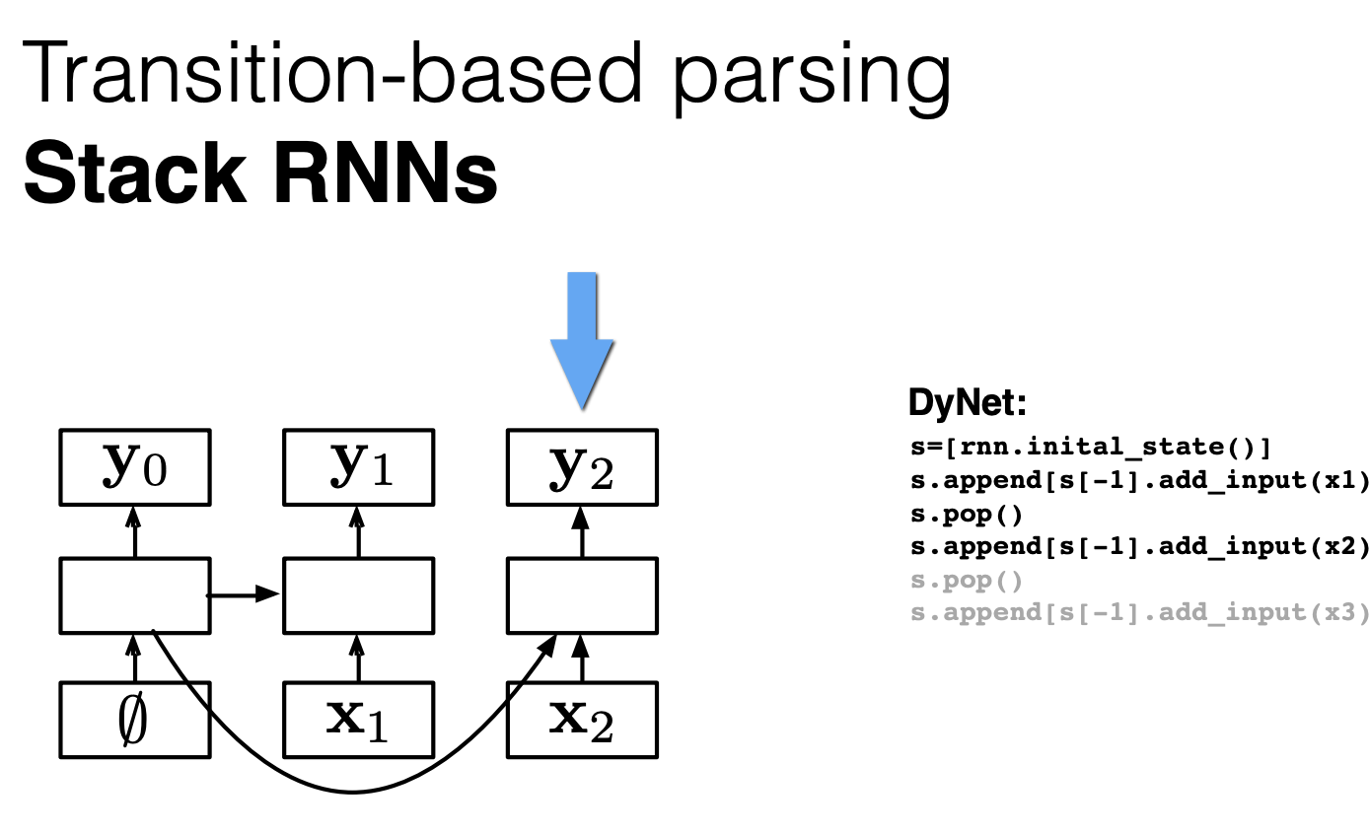

Slide 27
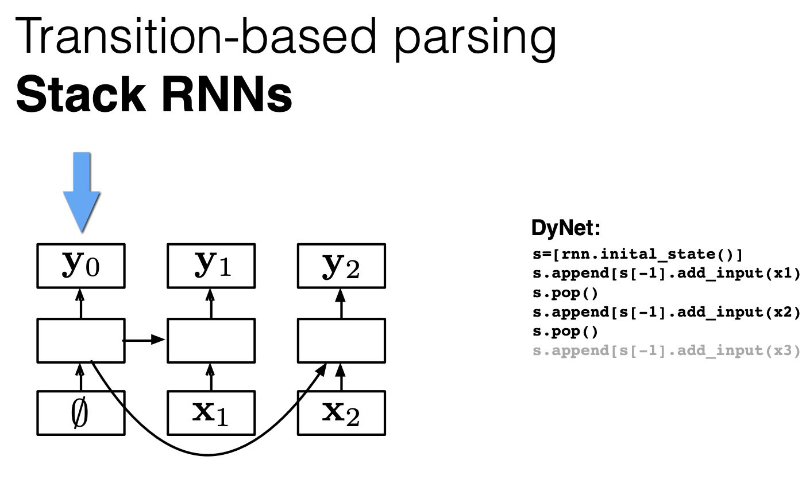

Slide 28
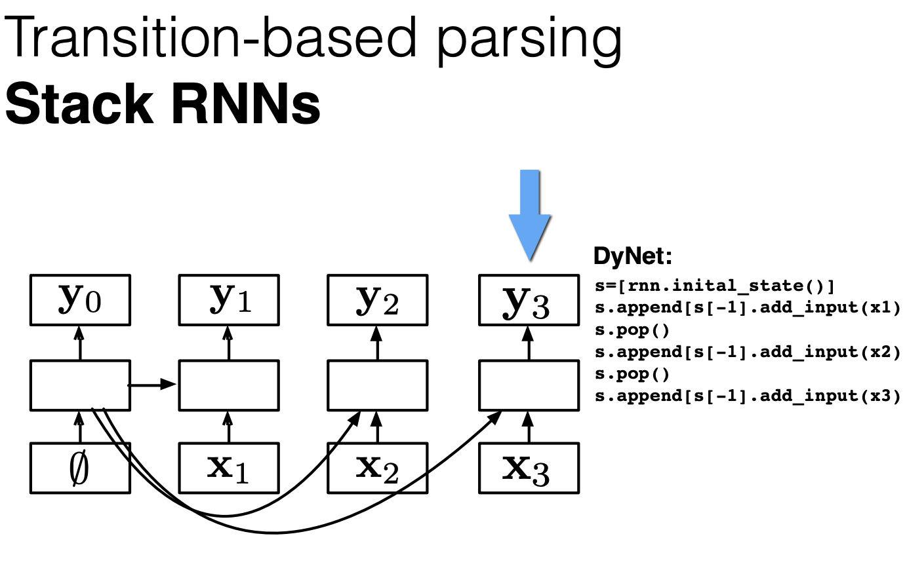

Slide 29
Catalogue
Recent Progress: Implement Transition-Based parser for CoNLL2019
Basic Transition-Based parser (Speech and Language Processing)
Research Highlight (Dependency parsing with stack-LSTMs)
Alternate Transition Systems: Arc-Eager

Slide 30
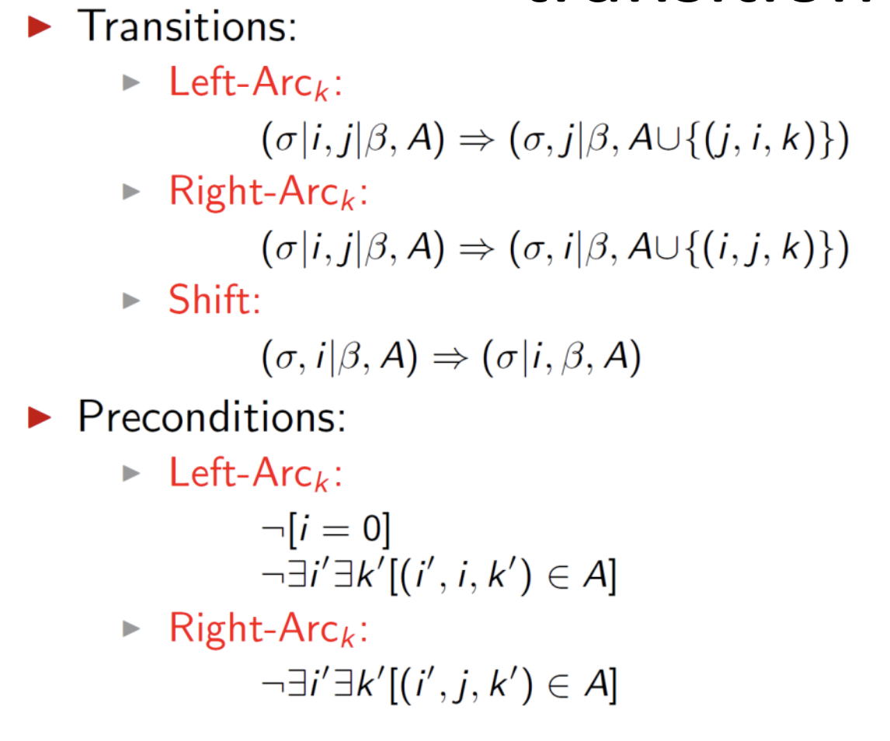
Note: A different way of writing arc-standard transition system

Slide 31
A weakness of arc-standard parsing
Right dependents cannot be attached to their head until all their dependents have been attached, i.e. book and flight in the Figure.

Slide 32
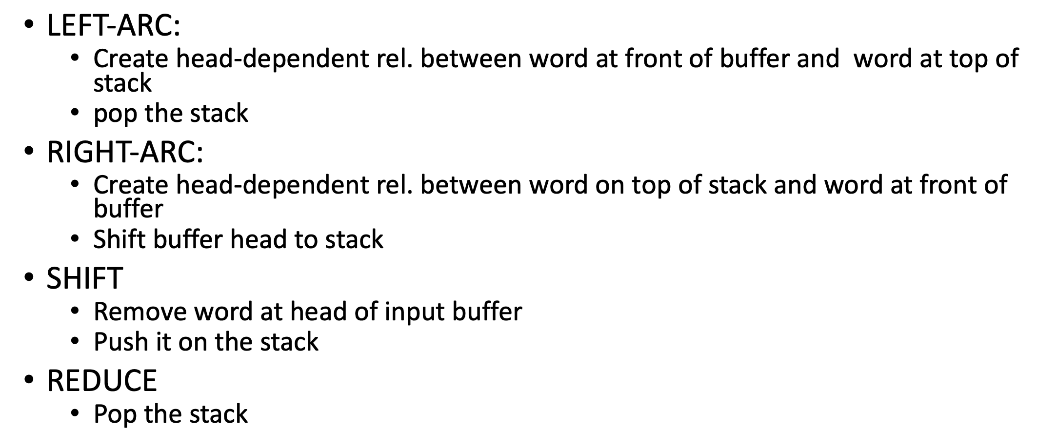
Arc Eager Parsing

Slide 33
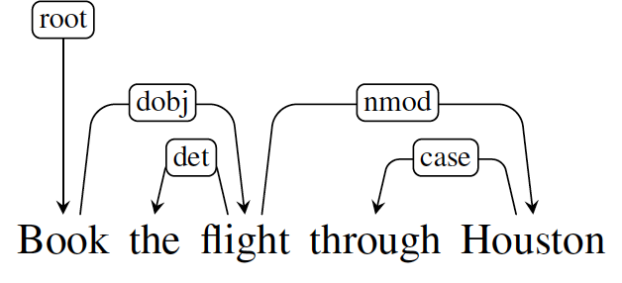
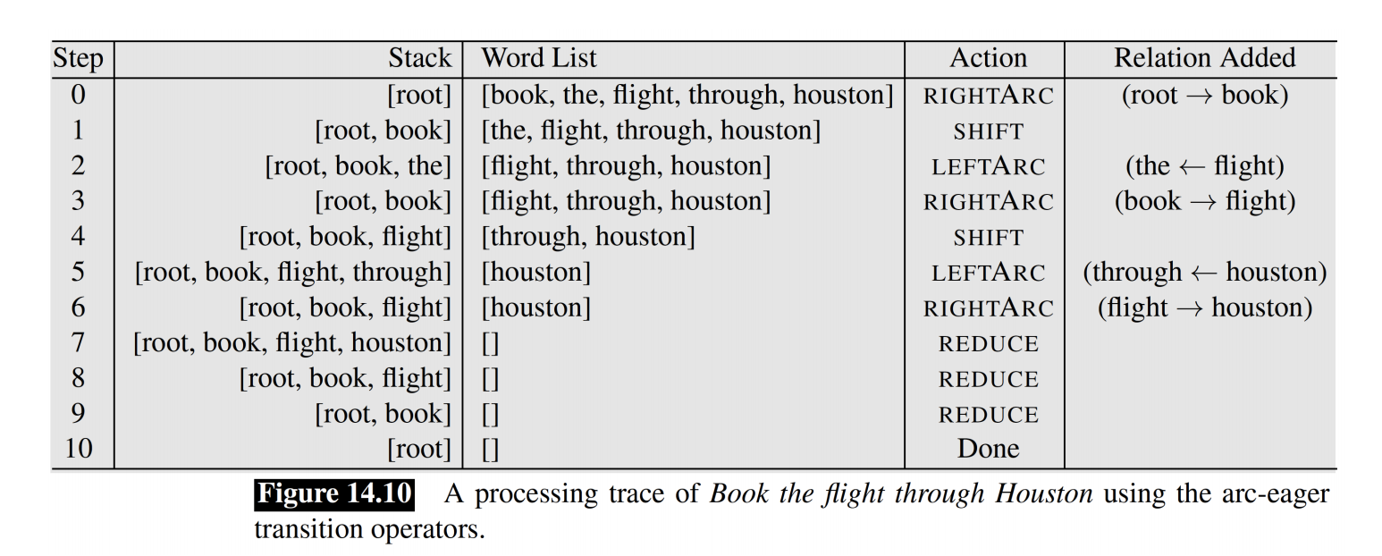
Arc Eager Parsing Example

